Slide 1
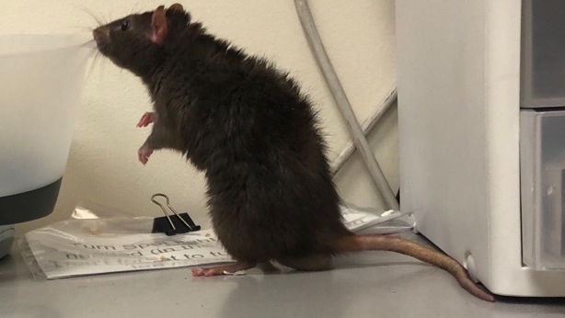
How do rats make explore-exploit decisions?
Siyu Wang & Blake Gerken, Advisor: Jean-Marc Fellous
Thank Hachi, Tianqi, Ratzo and Rizzo for their contribution to science.

Slide 2
Explore-Exploit Dilemma
www.scotthyoung.com

Slide 3
Explore-Exploit Dilemma
www.scotthyoung.com

Slide 4
The Horizon Task
Long
Horizon
Context
Short
Horizon
Context
www.scotthyoung.com

Slide 5
The rat task
Target feeders
Homebase

Slide 6
Rat Task #1:
Trial 1
Trial 2
Trial 3
Free choice 1
Free choice 2
…
Free choice N

Slide 7
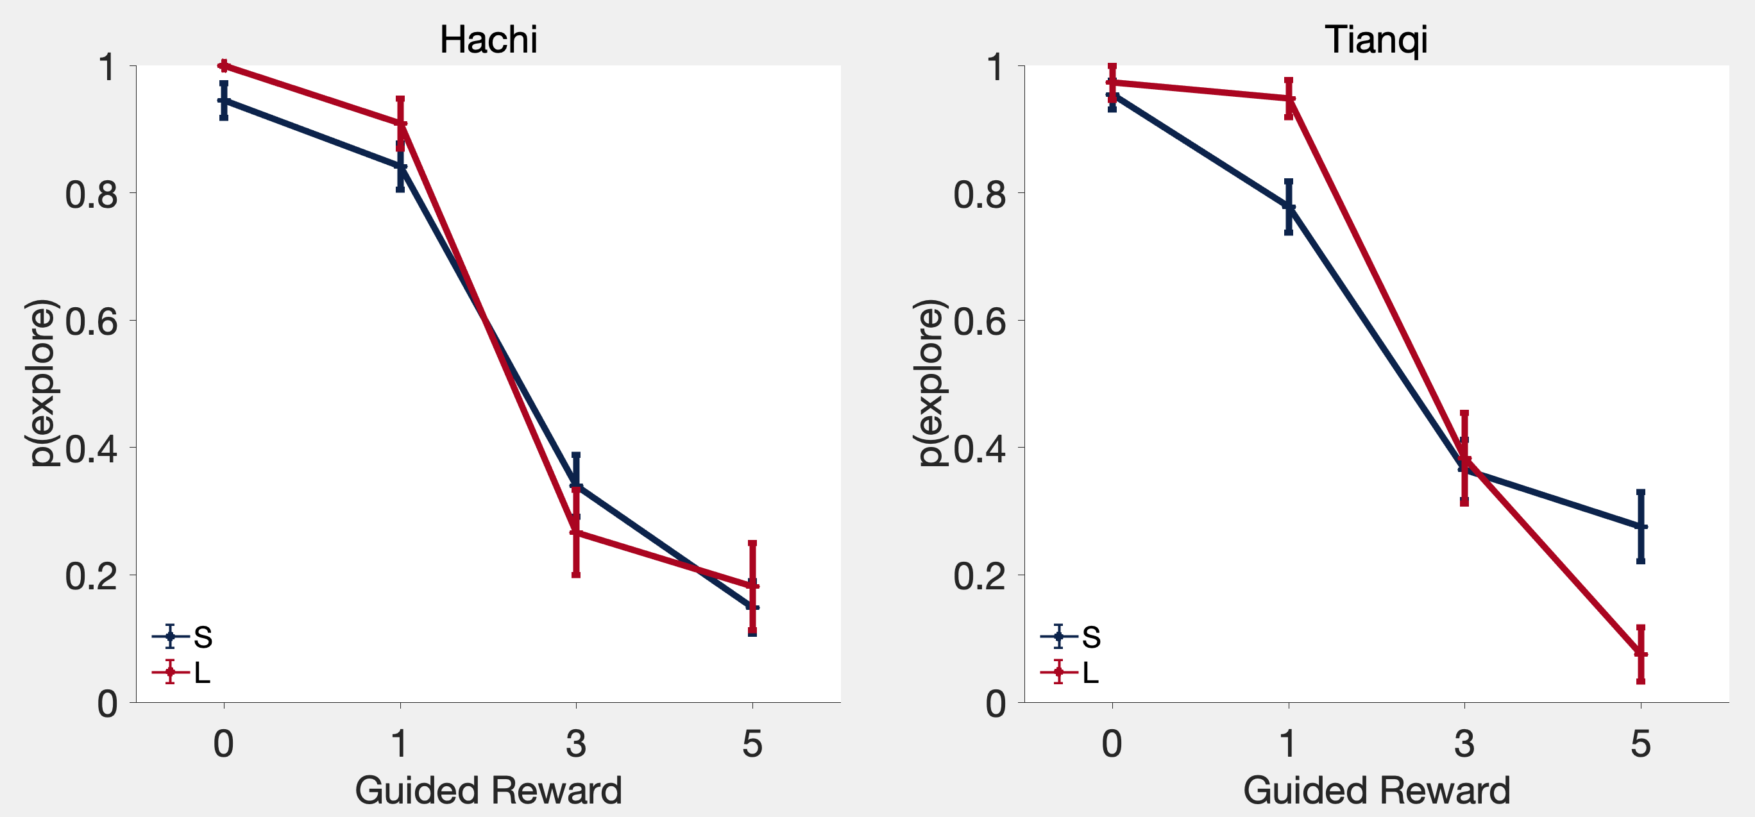
Preliminary result

Slide 8
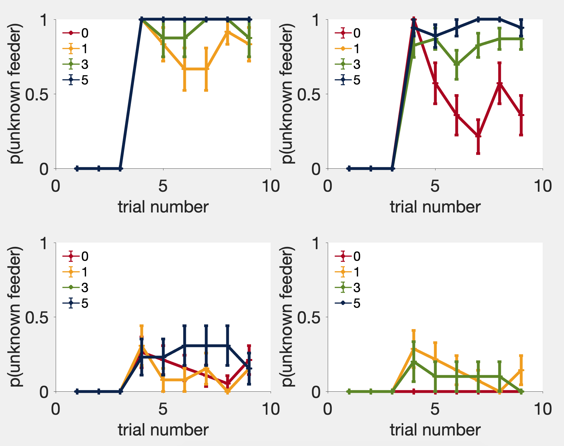
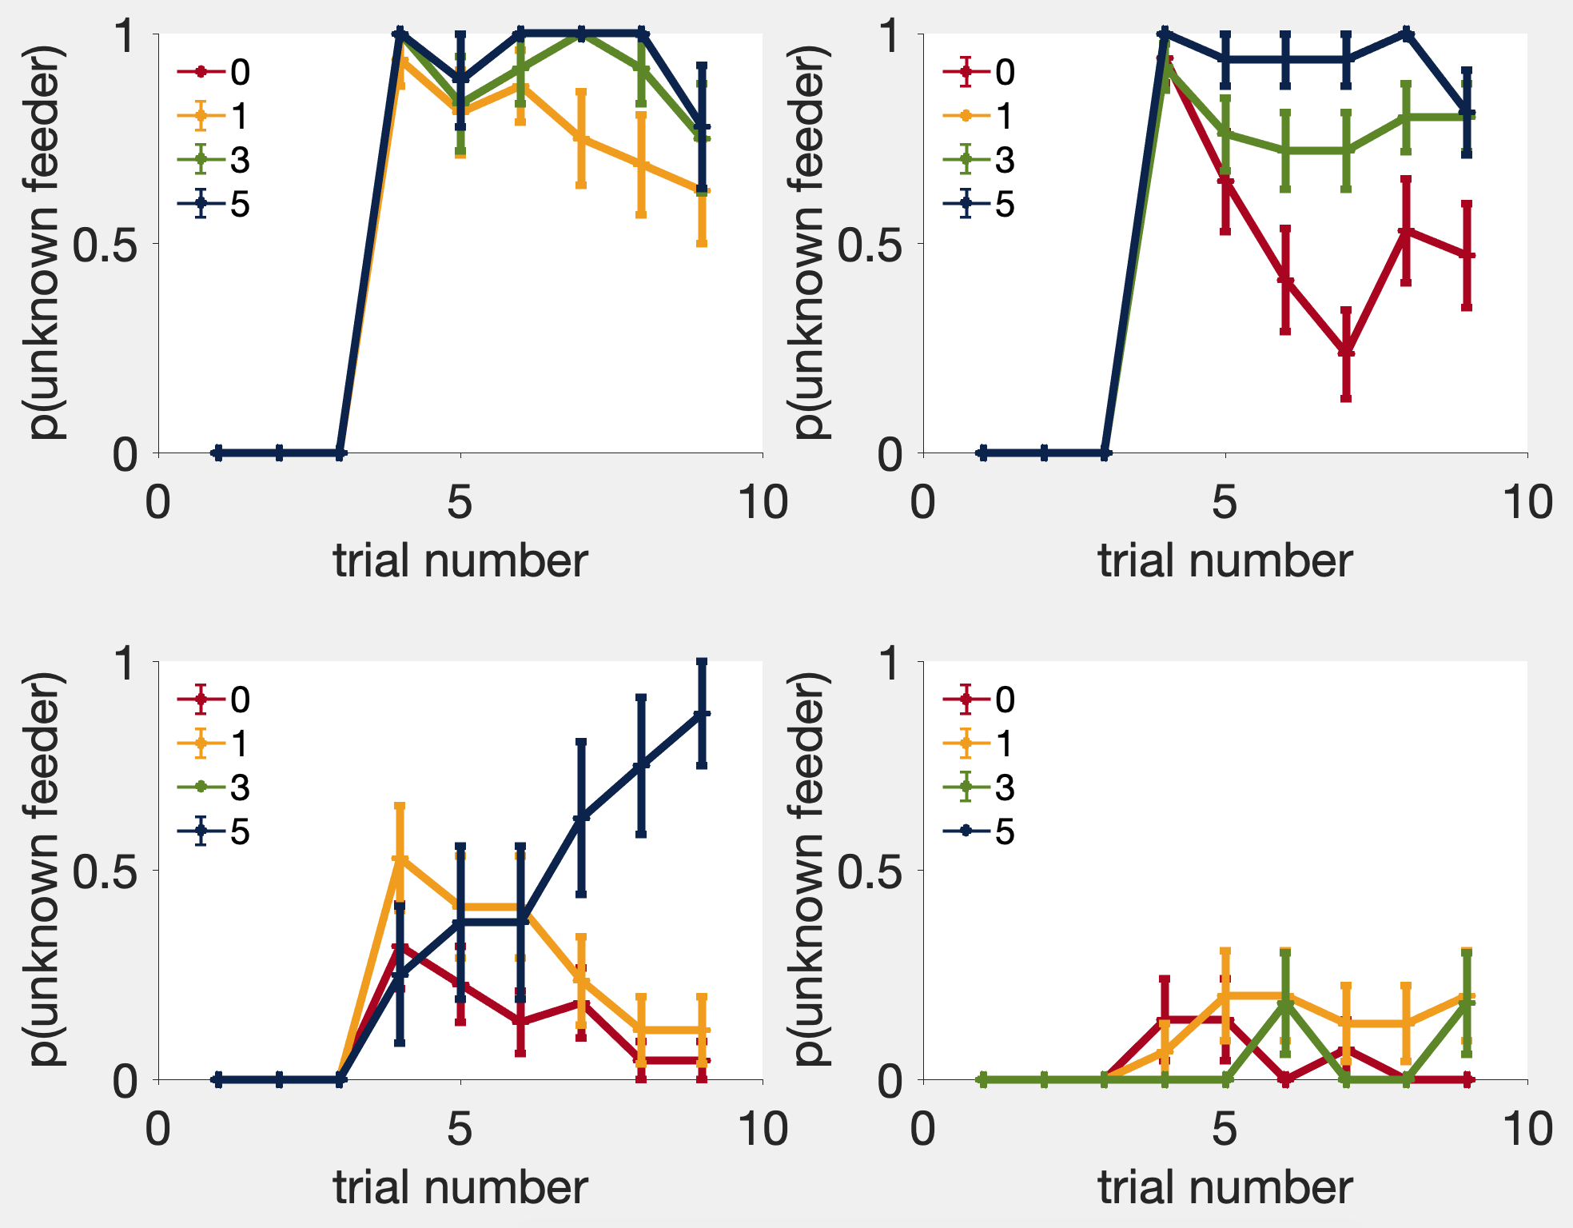
The full behavior
Hachi
Tianqi

Slide 9
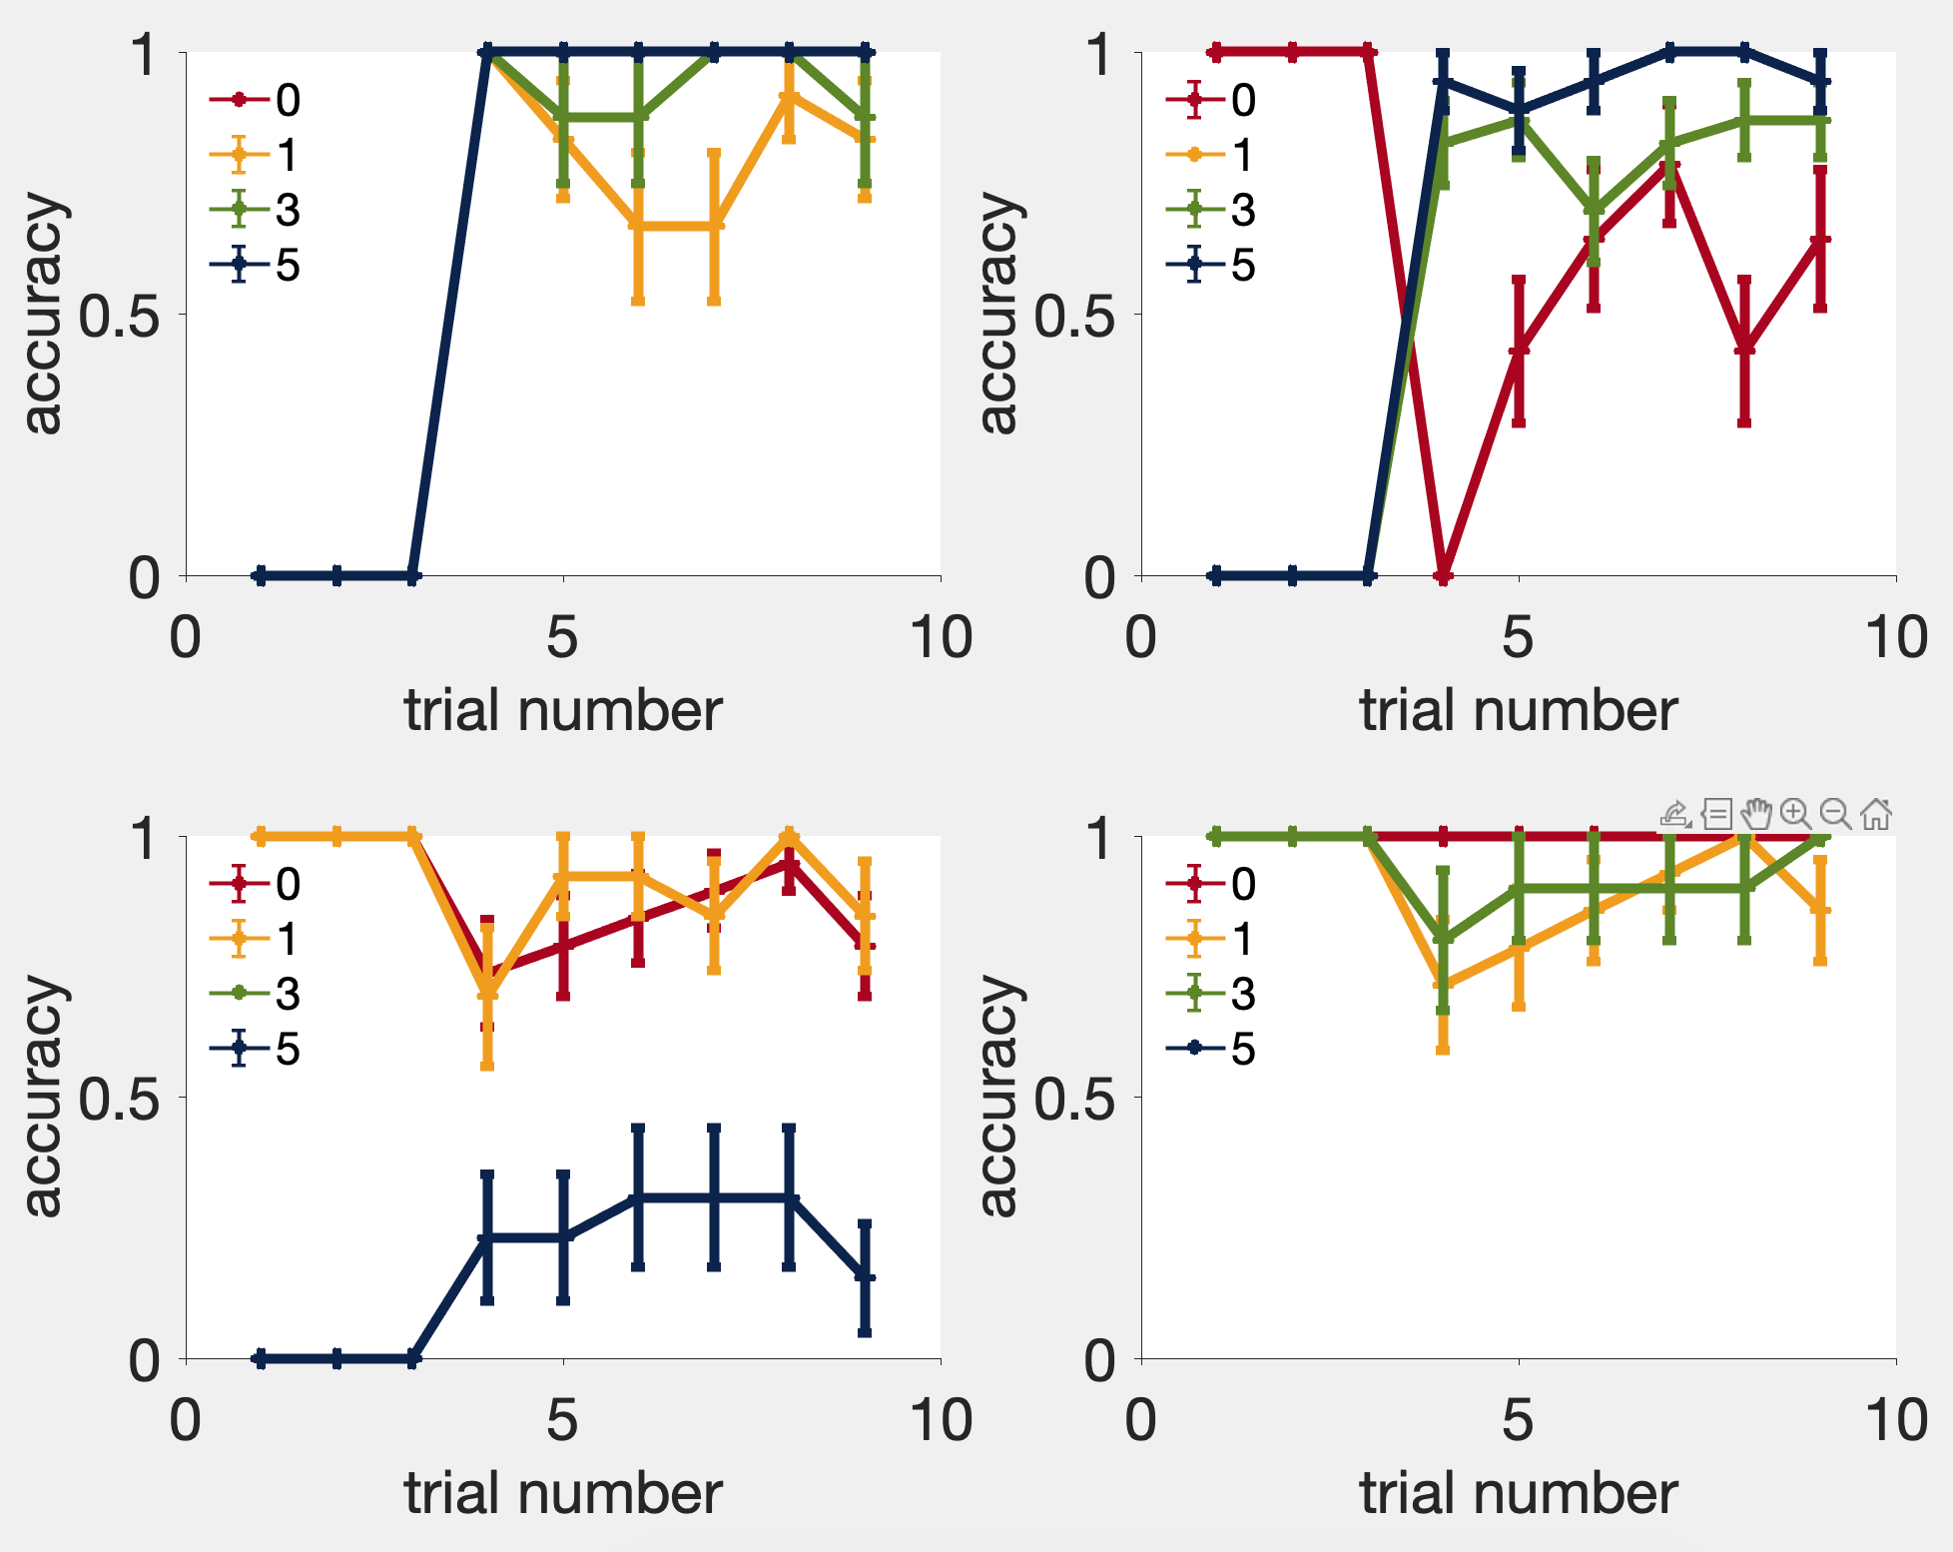
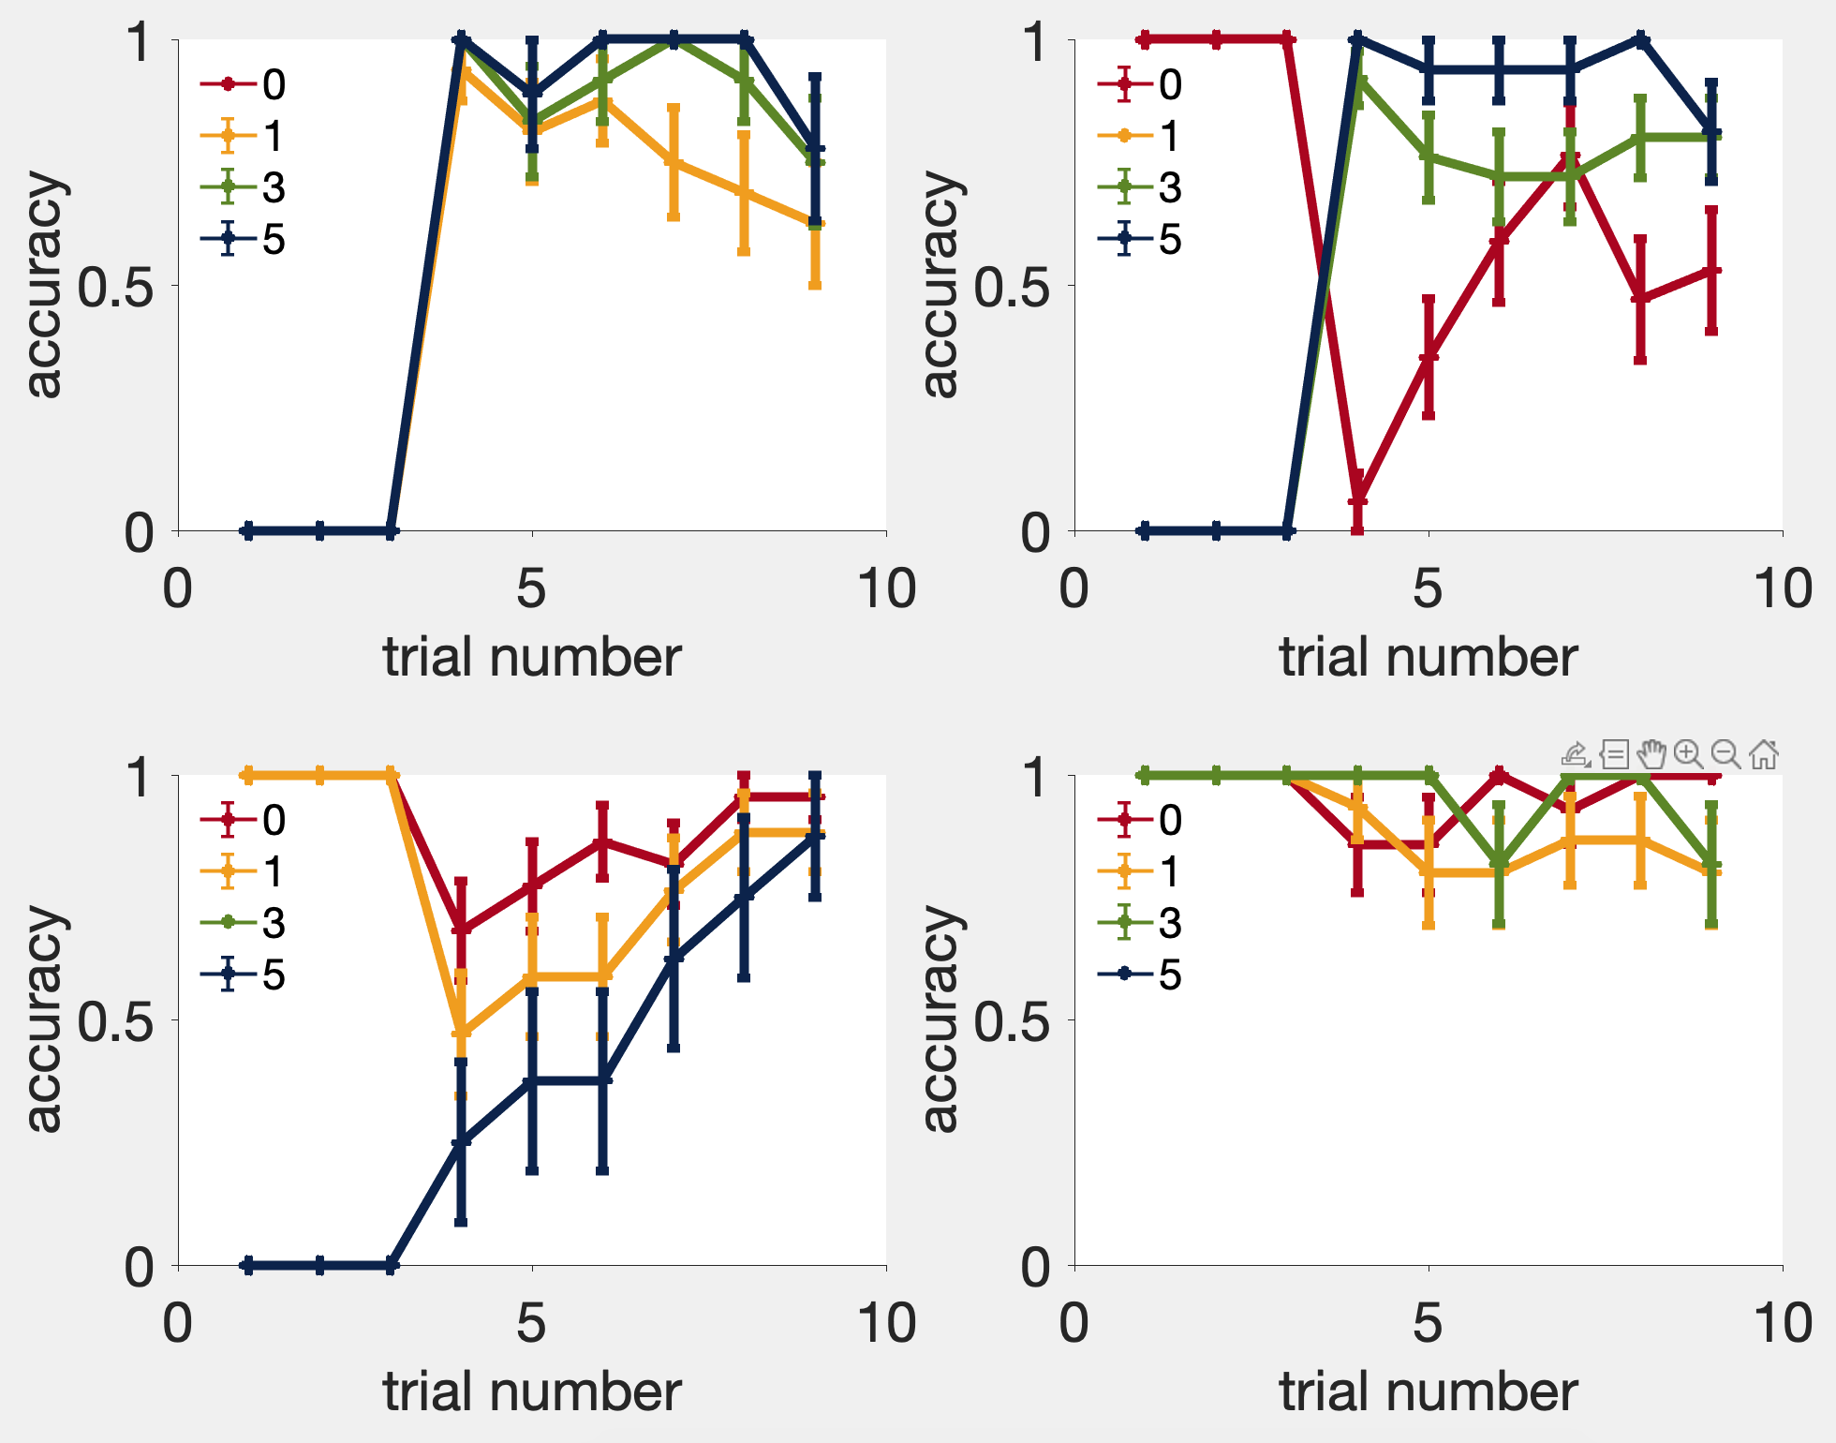
Accuracy
Hachi
Tianqi

Slide 10
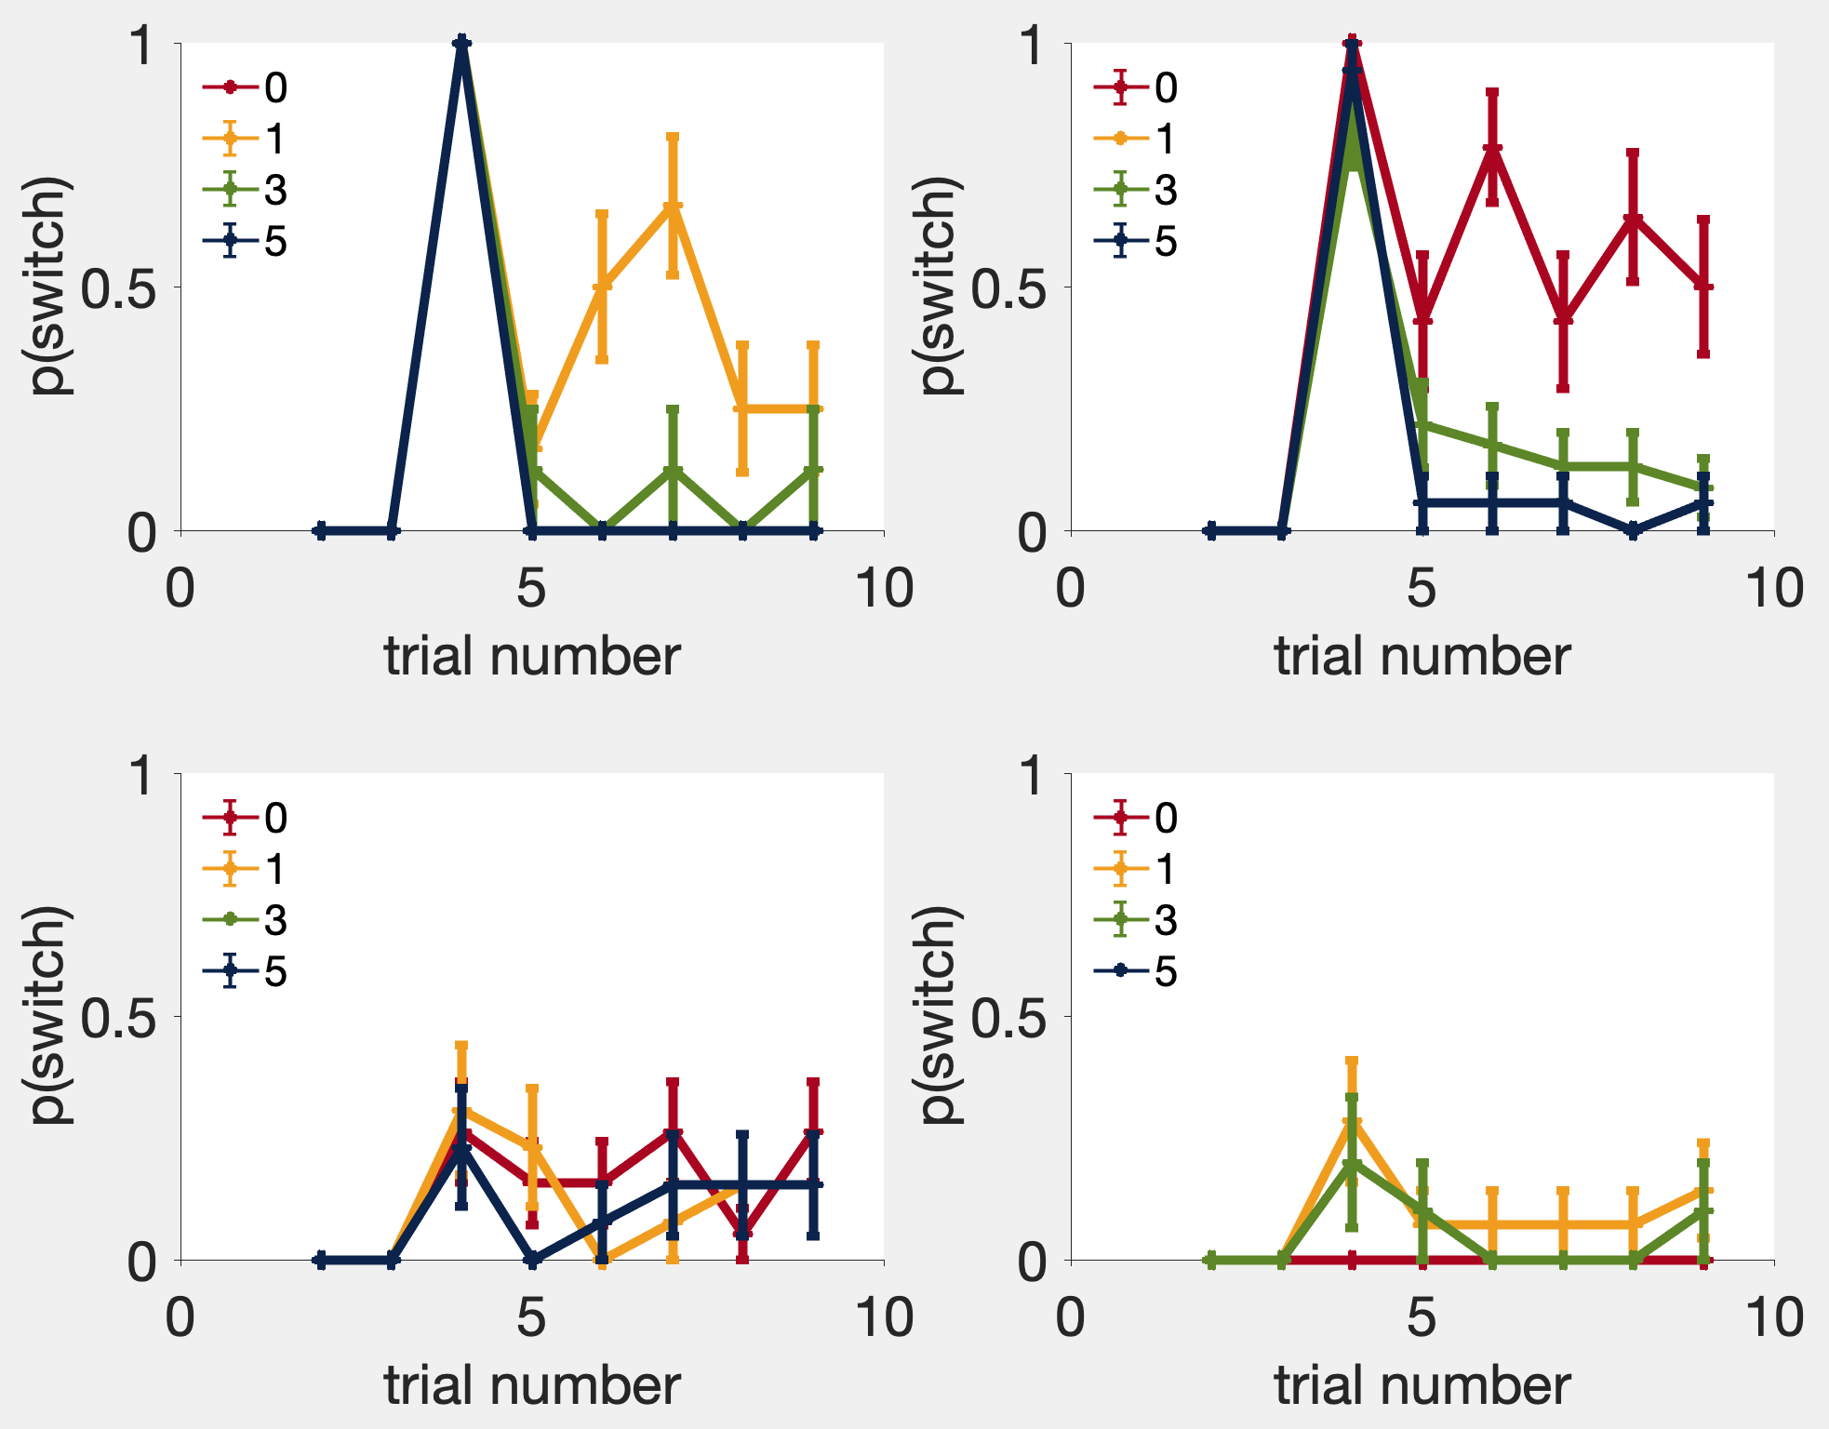
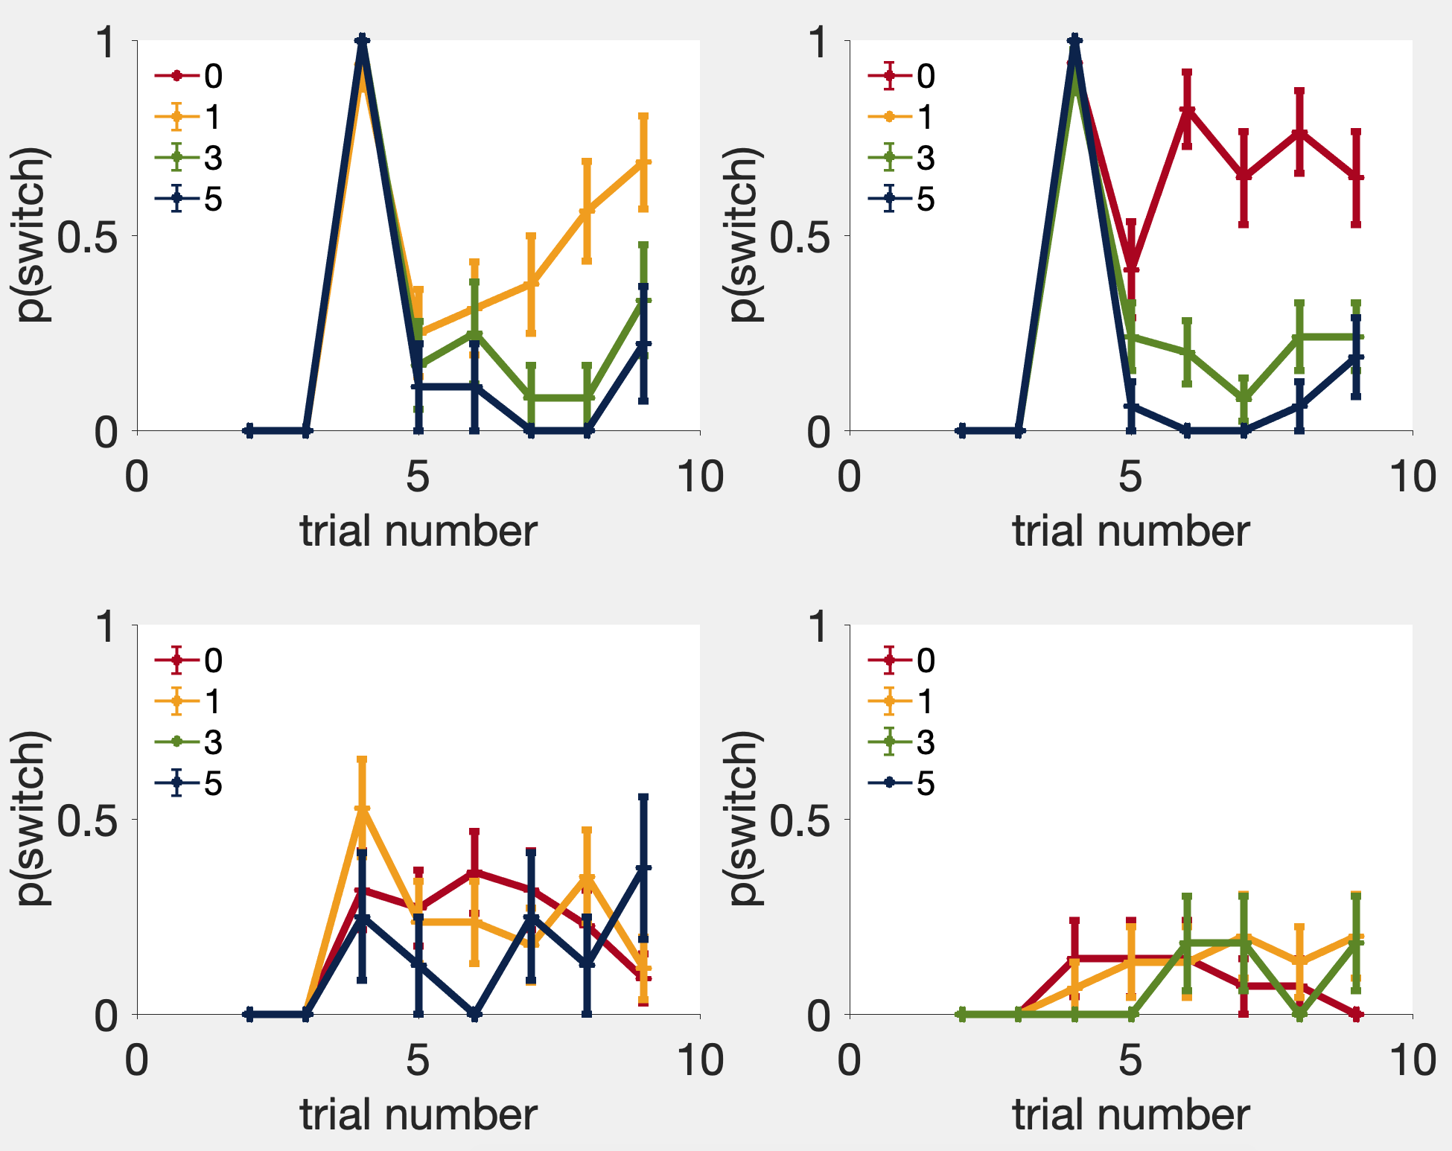
P(switch)
Hachi
Tianqi

Slide 11

Rat Task #2:
Trial 1
Trial 2
Trial 3
Free choice 1
Free choice 2
…
Free choice N

Slide 12
Rat Task #3 (a):
Trial 1
Trial 2
Trial 3
Free choice 1
Free choice 2
…
Free choice N

Slide 13
Rat Task #3 (b):
Trial 1
Trial 2
Trial 3
Free choice 1
Free choice 2
…
Free choice N

Slide 14
Thank you for your attention!
Next steps:
Run task version #2 and #3.
Add sound cues to facilitate training.
(Hopefully) Run an electrophysiology rat in late summer.
Acknowledgement:
Blake, Jean-Marc
Maddie, Blaine, Kristine, Yuxin, Jerry, Zhuocheng, Sarah
Rats: Hachi, Tianqi, Ratzo & Rizzo

